Slide 1

Traffic Incident Management
Analyzed for Interstates
Nashville, Tennessee
Suzanne Saggio
Nashville Software School - DDA5

Slide 2

From the Source
Lane Blockage Duration with and without TDOT Response
Impact of Weather Conditions on Traffic
High Impact Incident Days
Peak Periods of the Year
Interstate Network Hotspots
Interactive Dashboard

Slide 3

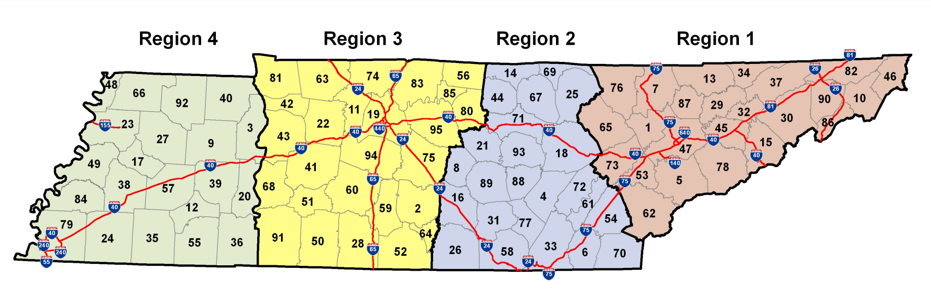
TDOT Regions

Slide 4
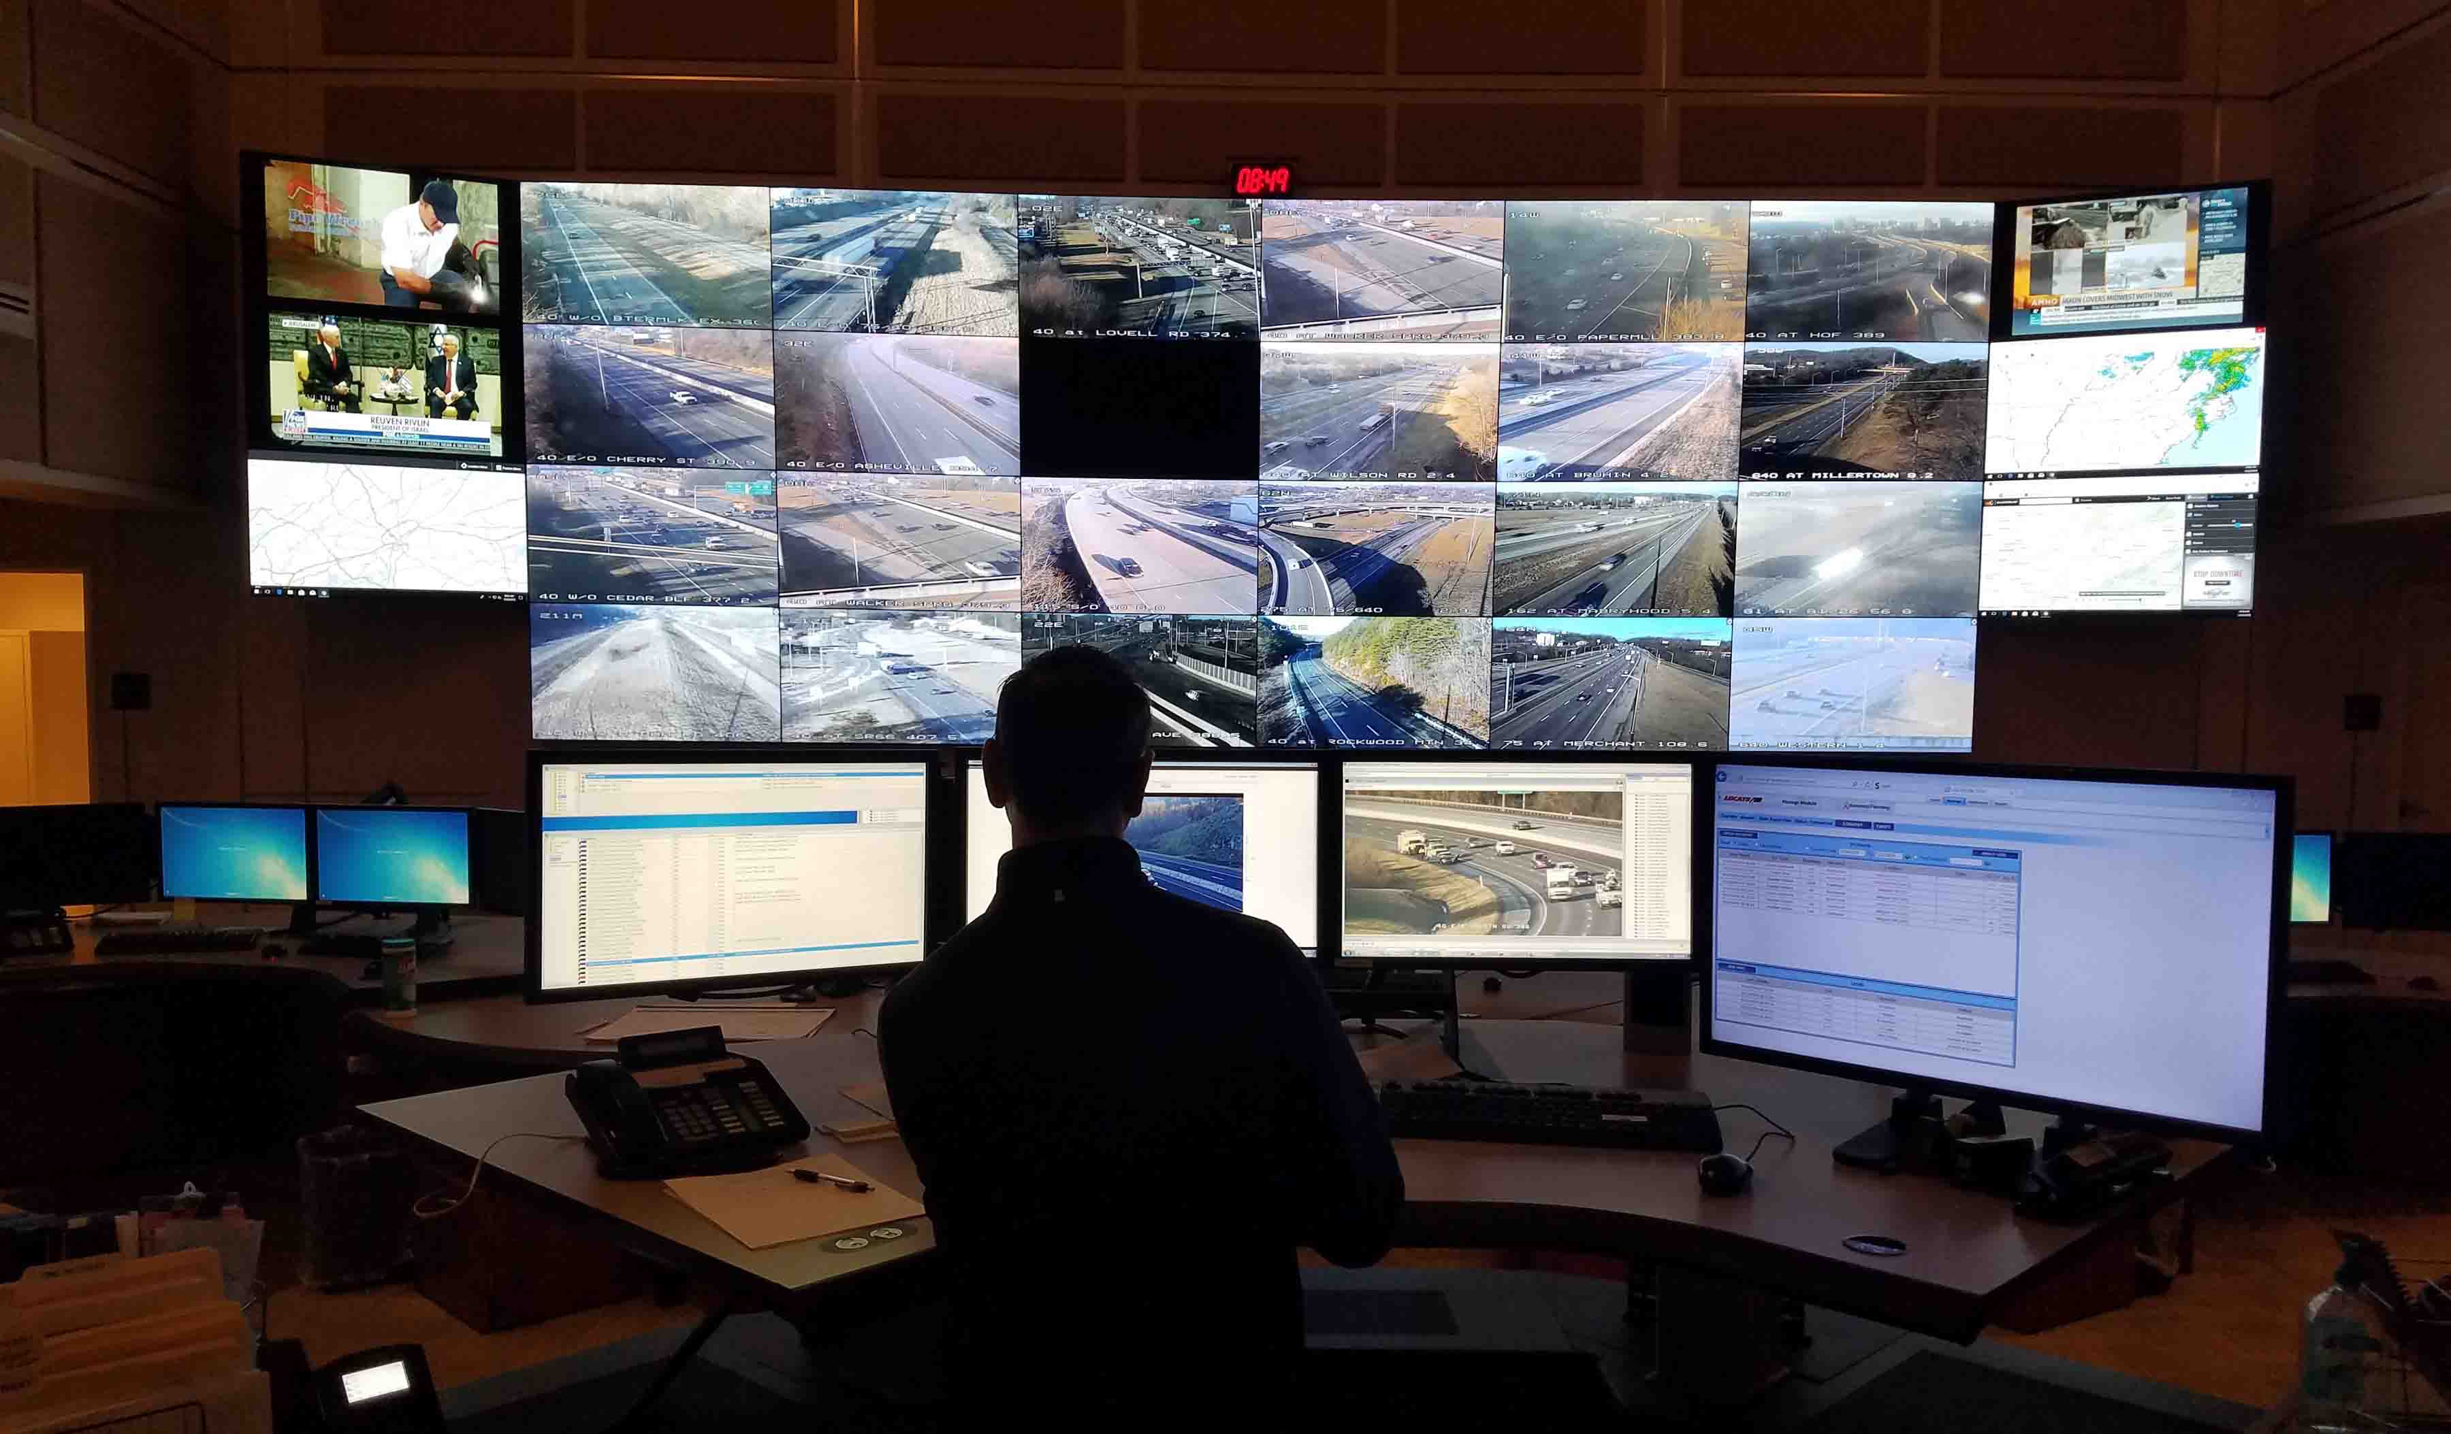

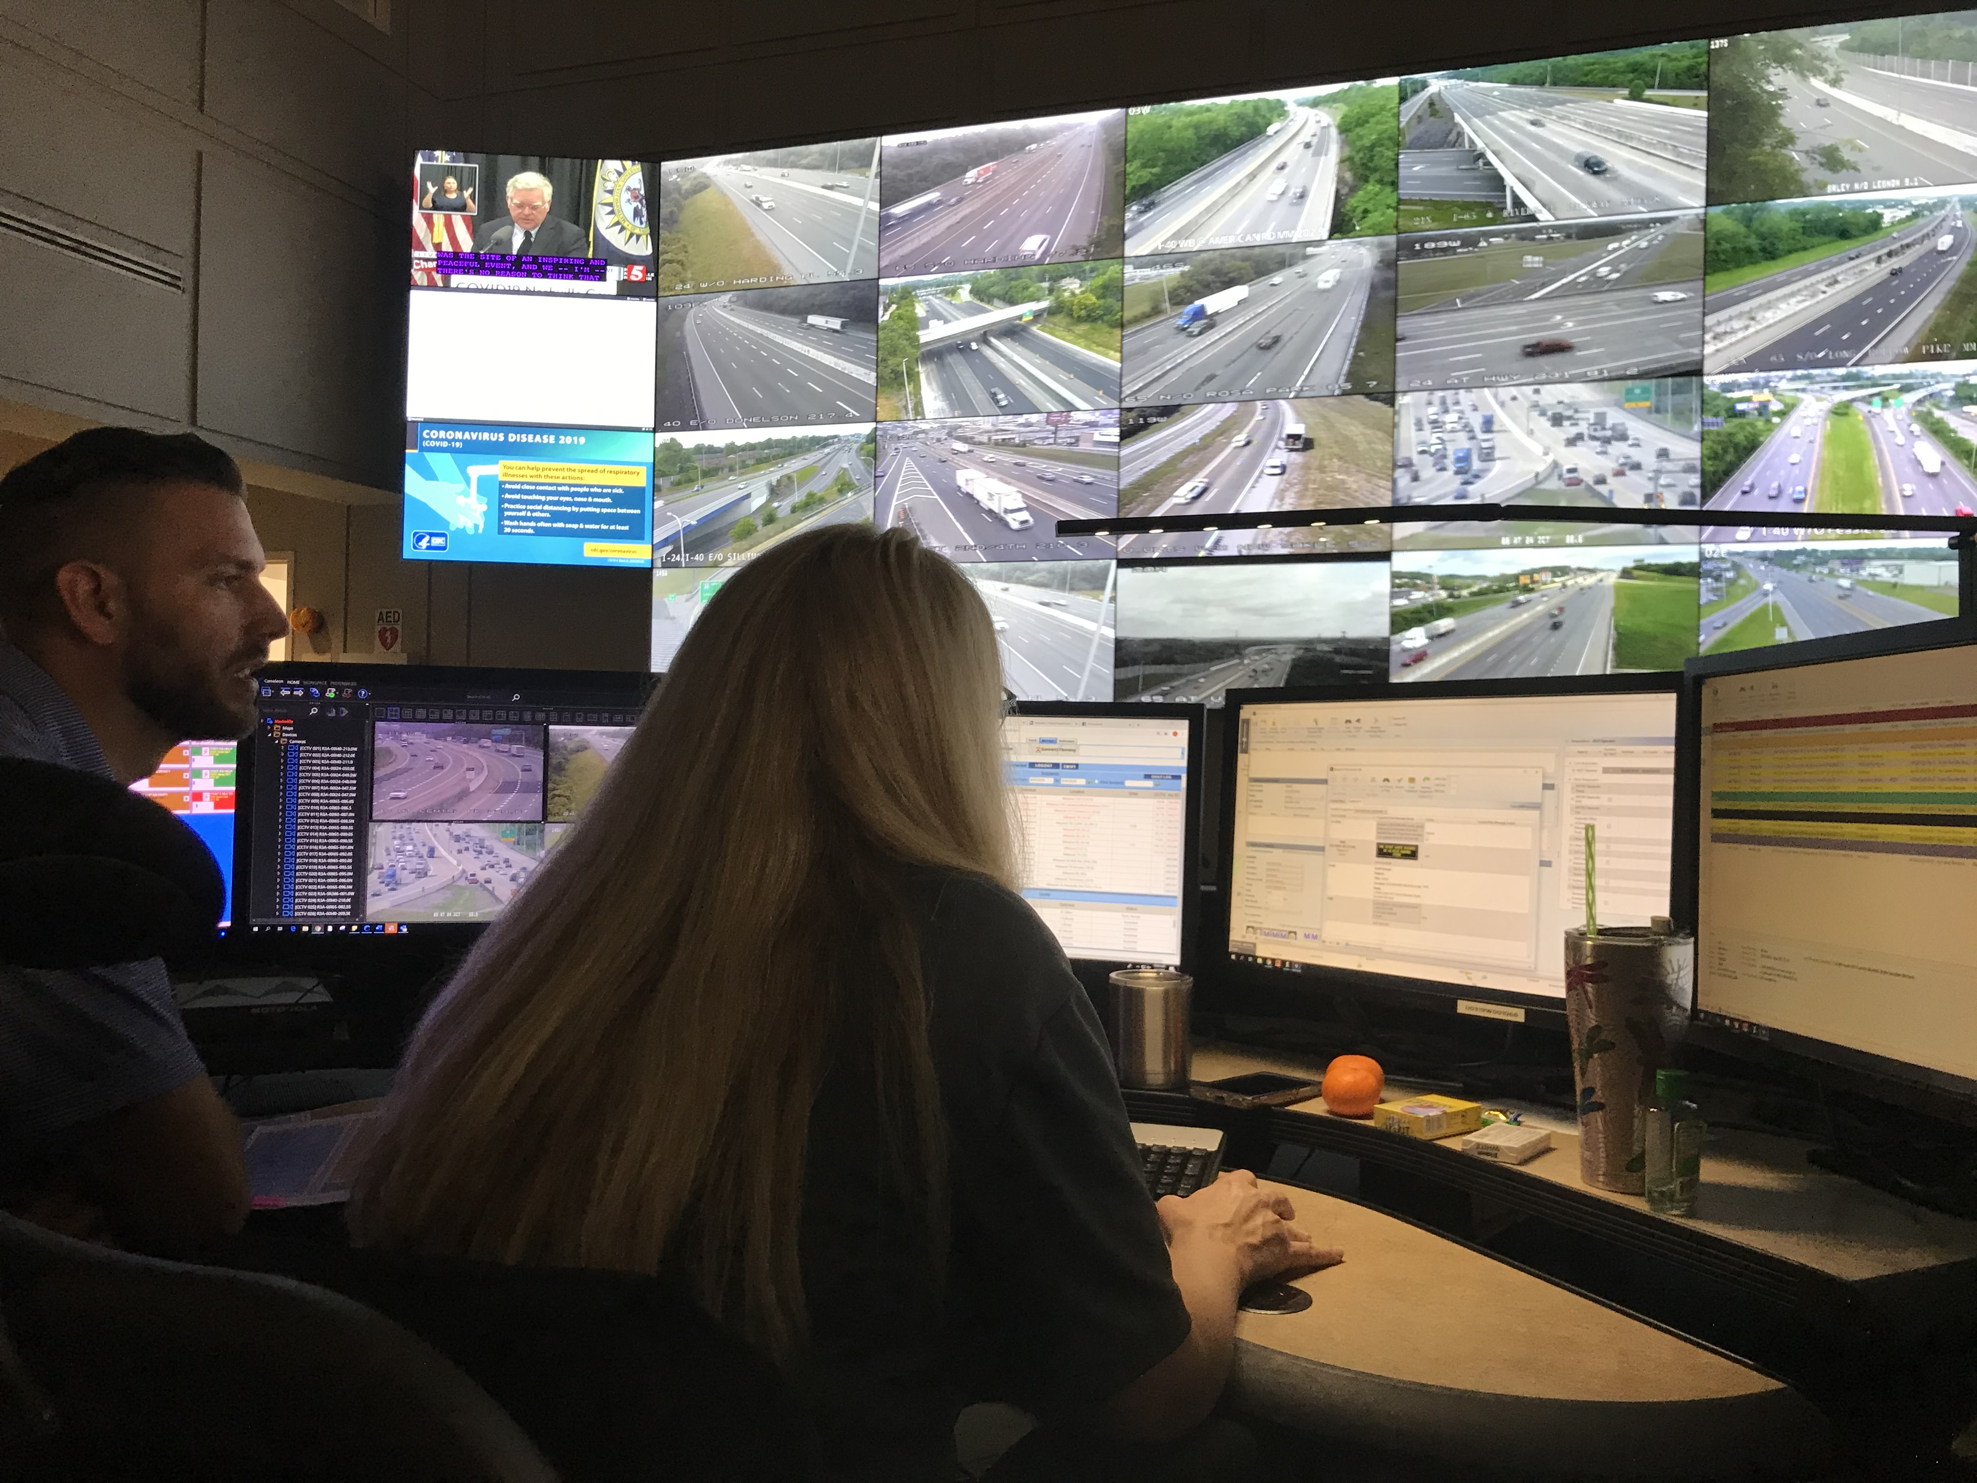
TDOT Region 3 TMC

Slide 5


Nashville, TN
Traffic Incident Management (TIM) consists of a planned and coordinated multi-disciplinary process to detect, respond to, and clear traffic incidents and restore traffic flow as safely and quickly as possible.
Largest City in US
Largest City in Tennessee
Population
2020 689,447
601,222
13% Increase

Slide 6
The Balance of Safety and Mobility
Duration
Impacts of Traffic Incidents
Length of Blockage Time
Detour Options
Lanes Closed or Blocked
Impedes Flow
Improves Safety
Reduce Secondary Crashes
Motorists
Crash Victims
Emergency Responders
Prevention
Support
Traffic Control Devices

Slide 7
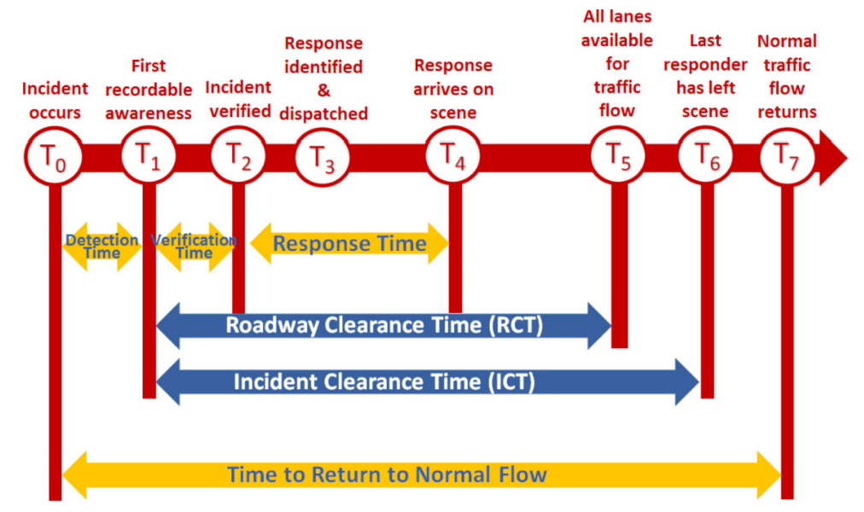
FHWA Incident Timeline

Slide 8
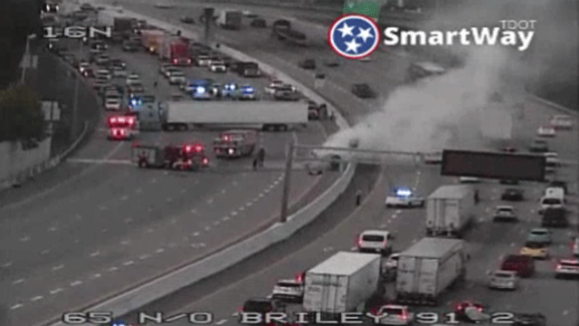
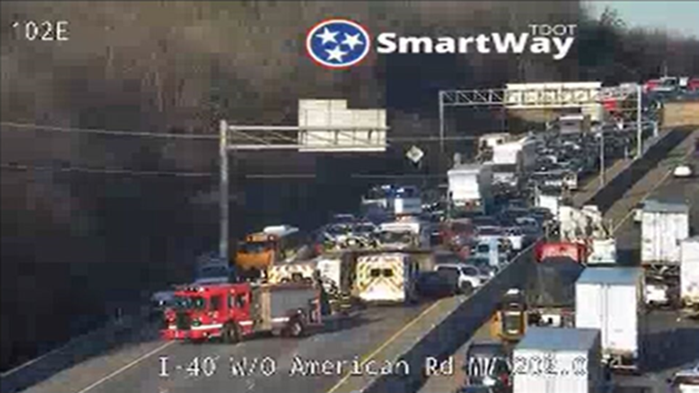
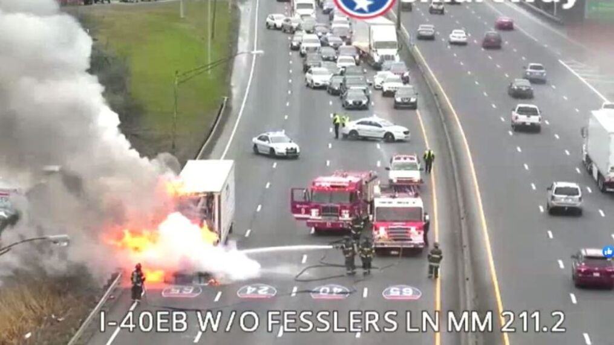
Data Analysis on Interstate Highways
Data
Period
Process
TDOT TMC Incident Database
TDOT Asset Management
National Weather Service
FHWA Operations Procedures
The data was vetted with background assistance from various TDOT employees.
The data that was used in the analysis was a matter of background knowledge from TDOT.
There were requests made per TDOT, which influenced analysis conducted.
Nov 1, 2020 to Oct 31, 2021
Traffic Data
Weather Data
Asset Management Data

Slide 9
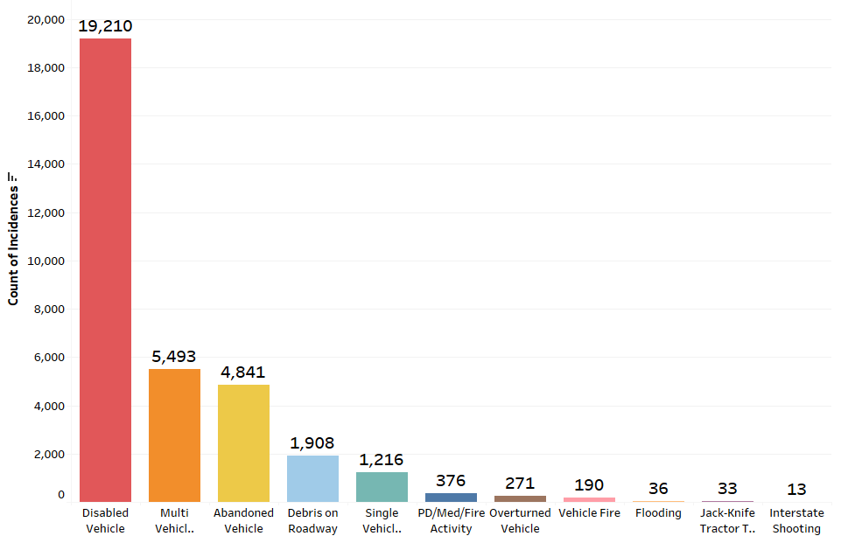
Overview of Incident Types
Top 8 Incidents
Disabled Vehicles | 19,210
Multi Vehicle Crash | 5,493
Abandoned Vehicle | 4,841
Debris on Roadway | 1,908
Single Vehicle Crash | 1,216
PD/Med/Fire Activity | 376
Overturned Vehicle | 271
Vehicle Fire | 190
5 Focal Incidents
Multi Vehicle Crash
Single Vehicle Crash
Overturned Vehicle
Vehicle Fire
Jack-Knife Tractor Trailer

Slide 10
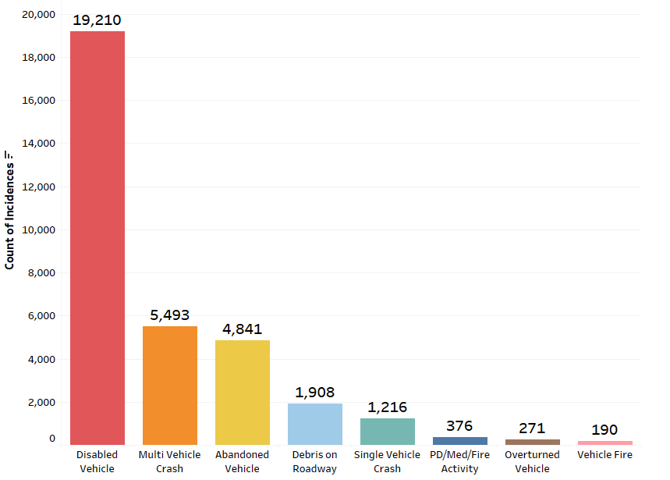
Top 8 Incident Types

Slide 11
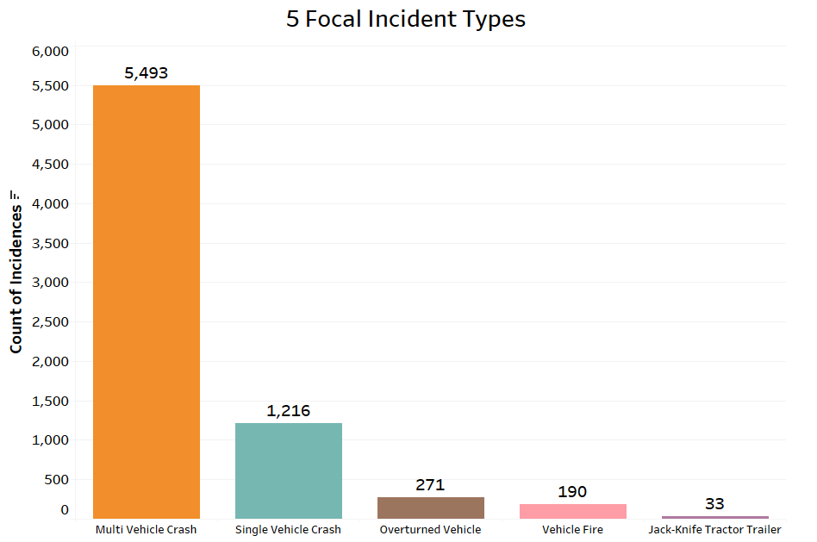
High Impact Incidents

Slide 12
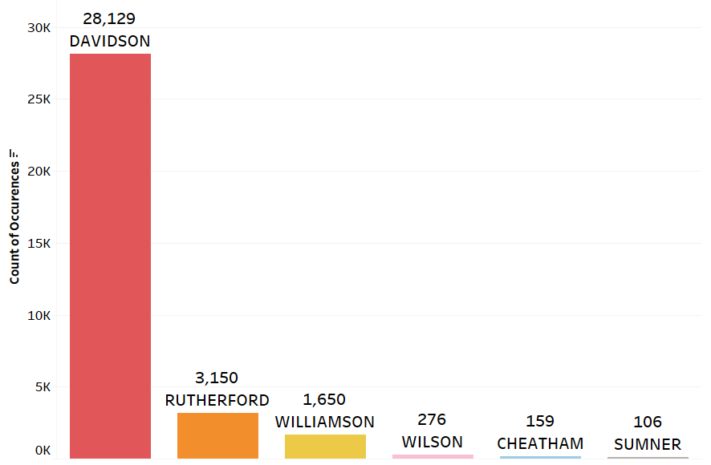
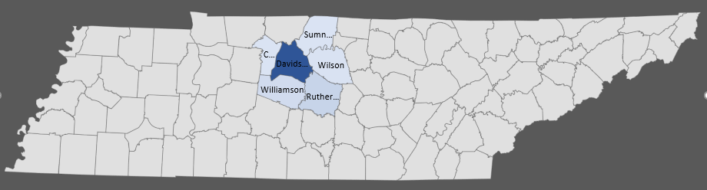
Incidents by County
Top 6 Counties
Davidson | 28,129
Rutherford | 3,150
Williamson | 1,650
Wilson | 276
Cheatham | 159
Sumner | 106

Slide 13
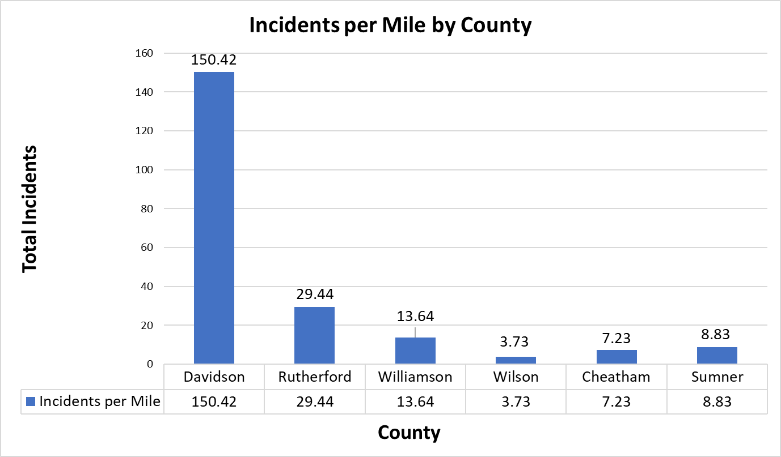
Incident / Mileage Analysis

Slide 14



Weather Conditions
Click icon to add picture
704
Clear
Rain
Snow
20,272
12,754
704

Slide 15
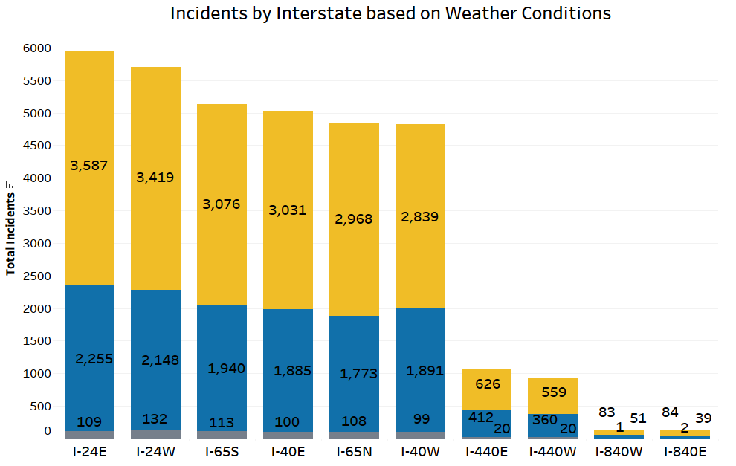



Interstate Weather Analysis
20,272
12,754
704

Slide 16
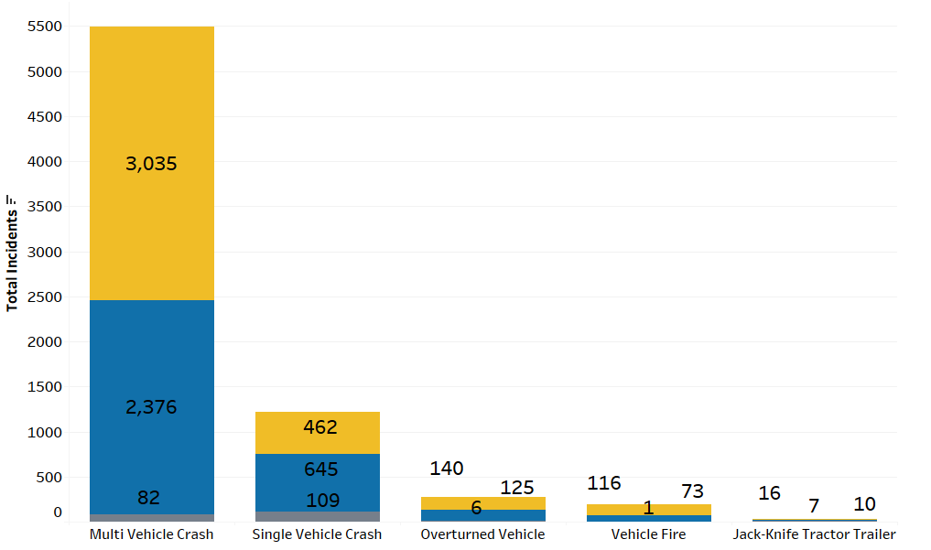
Incident Types based on Weather

Slide 17
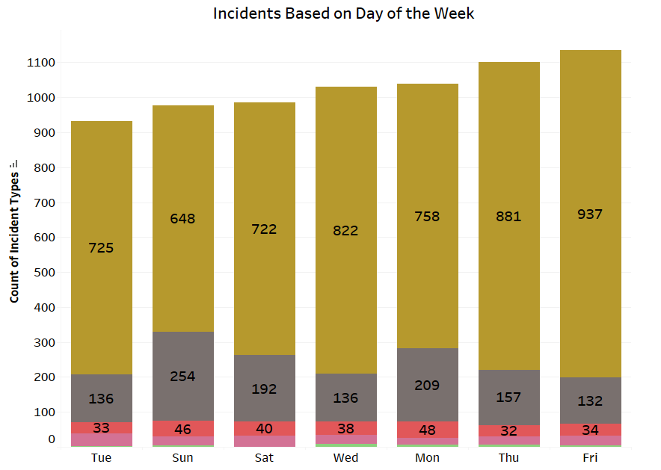
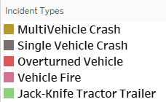
Incidents Throughout the Week
Total Incident Types
Tuesday | 932
Sunday | 977
Saturday | 986
Wednesday | 1031
Monday | 1040
Thursday | 1101
Friday | 1136

Slide 18
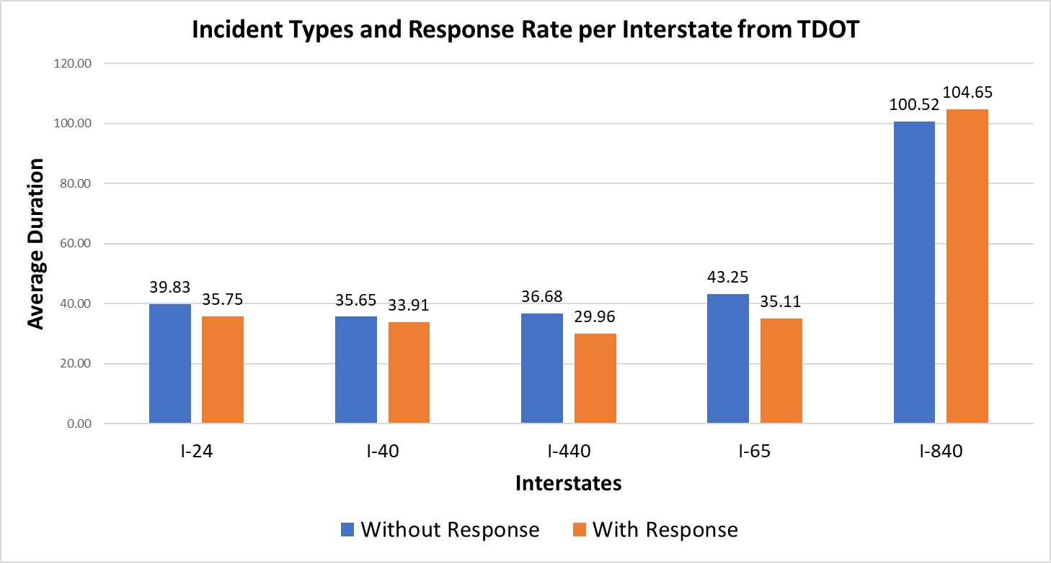
Clearance Time with Response

Slide 19
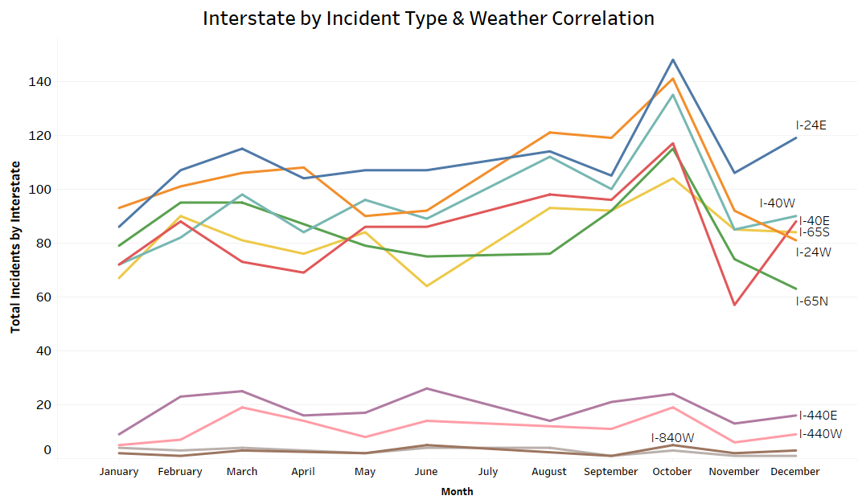
Interstate Analysis

Slide 20
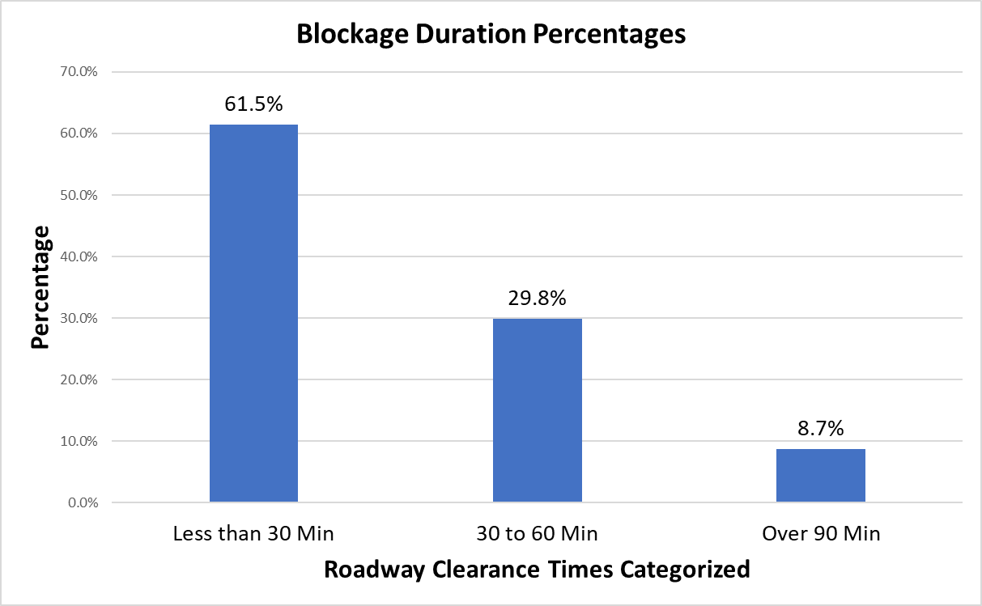
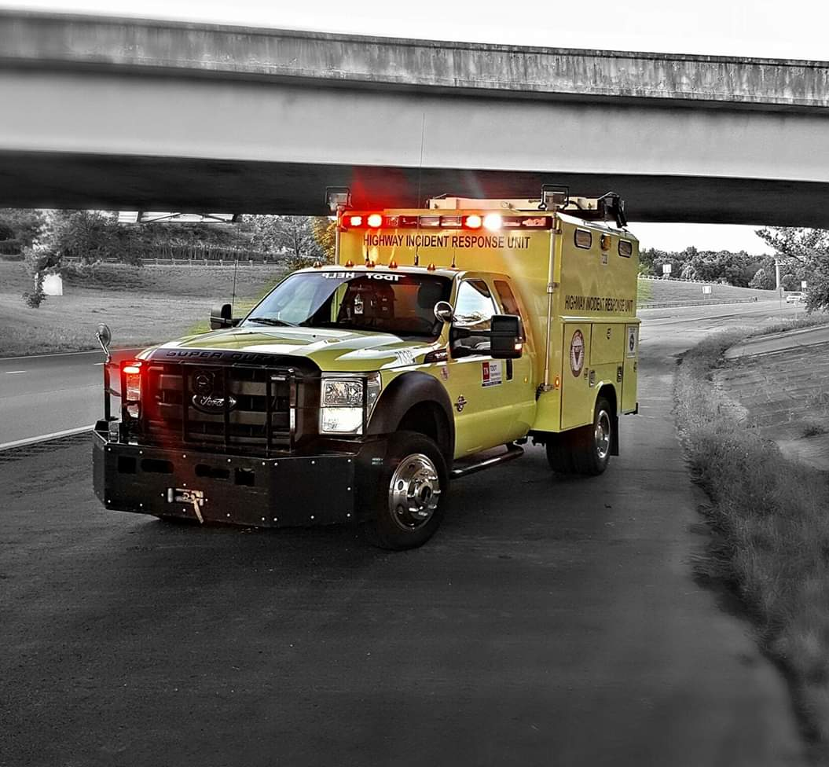
Roadway Clearance Times
Clearance Buckets
< 30 Min | 61.5%
30-60 Min | 29.8%
> 90 Min | 8.7%

Slide 21
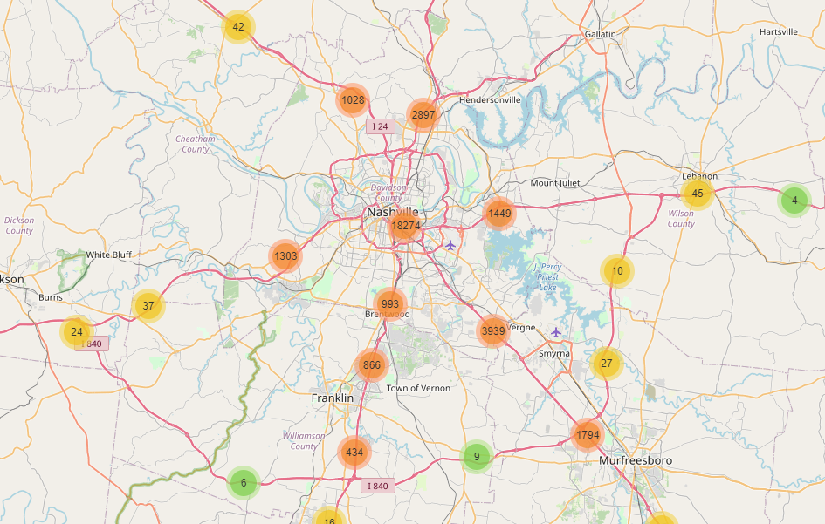
Incident Types Clustered

Slide 22
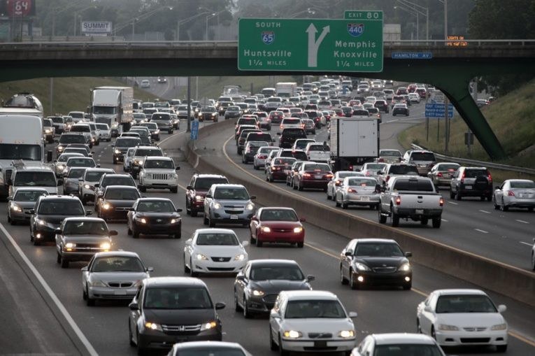
Reflection
Traffic Incident Management
To improve safety, reliability of travel, and efficiency of incident response
Technologies Used
Python/Pandas
Jupyter Notebook
Tableau
GitHub
PowerPoint
Excel

Slide 23
Traffic Incident Management
Analyzed for Interstates
Nashville, Tennessee
Suzanne Saggio
Nashville Software School - DDA5
suzannesaggio@gmail.com

